Slide 1
DATS 6101 – PROJECT ON CHILD CARE INSPECTION
Team number : 6
Team members:
1. Adina Dingankar 4. Rehapriadarsini Manikandasamy
2. Ashwin Arun Dixit 5. Yaqian Lin
3. Deyu Kong

Slide 2





AGENDA
About the Dataset
SMART Questions
EDA
Statistical Testing
Model Building

Slide 3
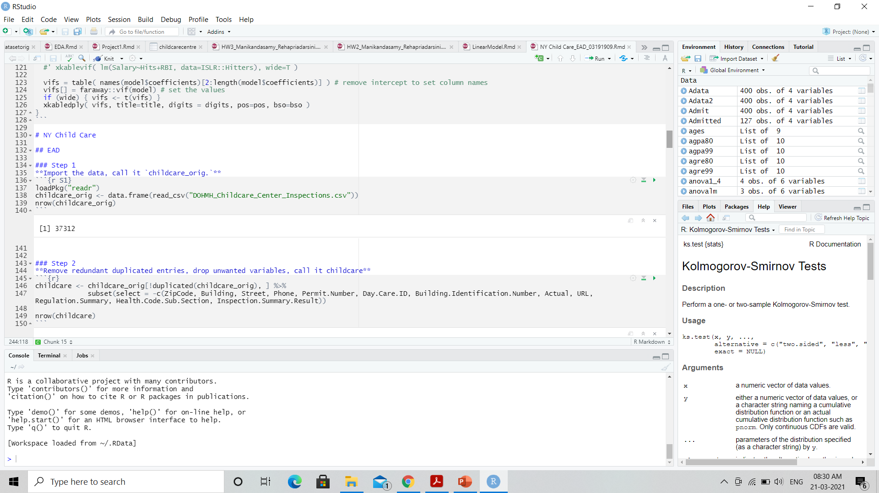
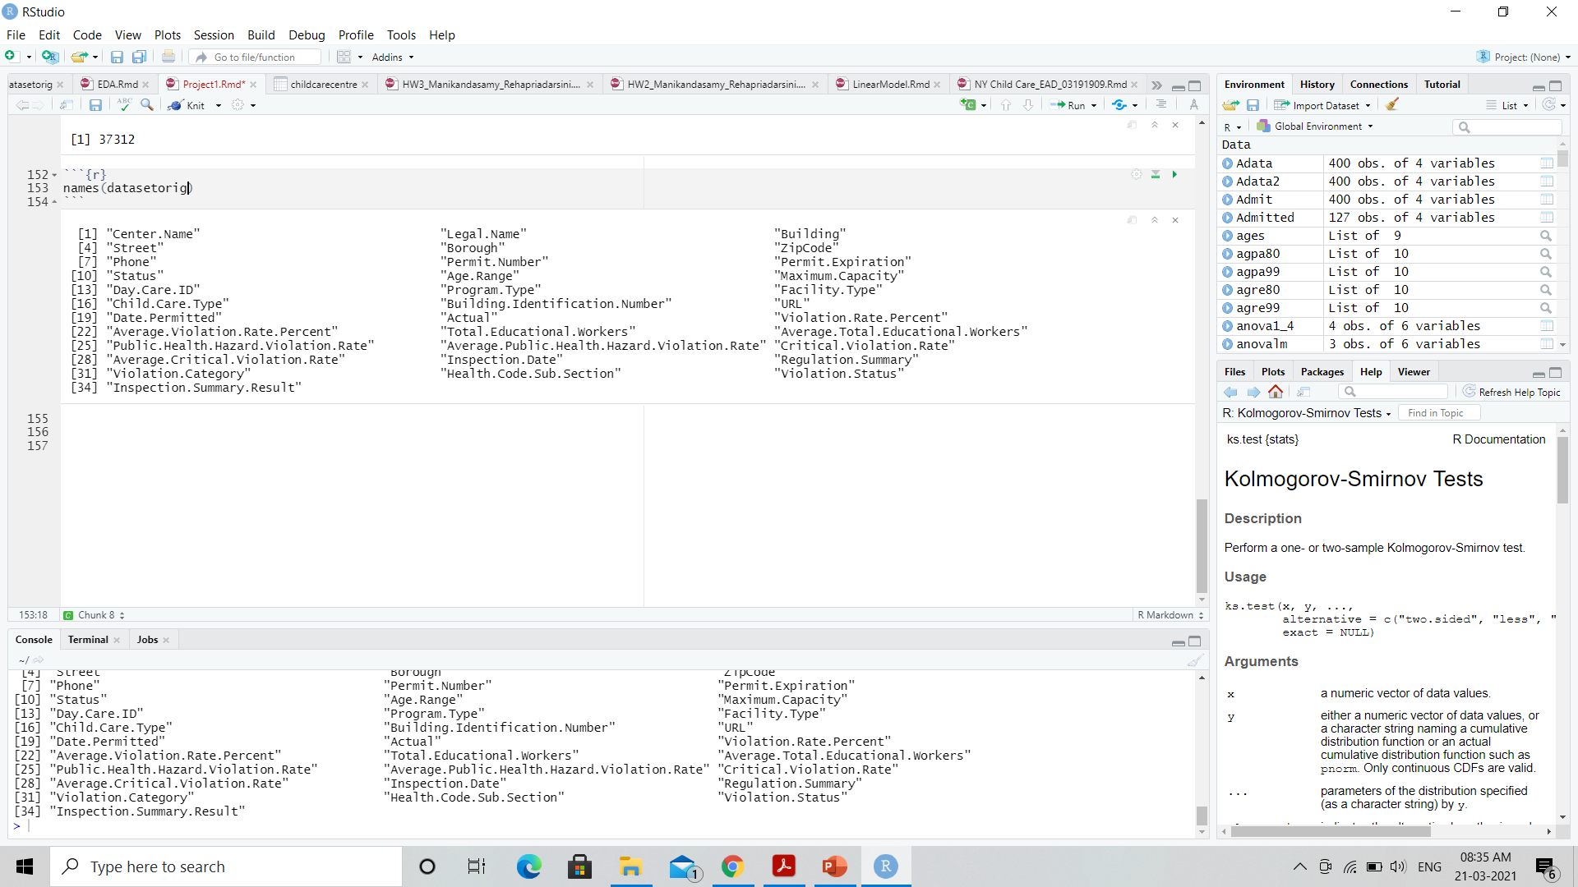
Dataset
The Child Care Inspection dataset contains a record of all investigations conducted and any related violations at active, city-regulated, center-based child care programs and summer camps over the years 2018-2021
Source : Department of Health and Mental Hygiene (NYC Open DATA repository)
Number of Observations : 37312 Number of Variables : 34

Slide 4
SMART Questions
To discover the distribution of Centers, Borough and Program Type
What is the percent of violations reported in each category in all the childcare centers?
Which borough has improved over the period (2018-2021)?
SPECIFIC
MEASURABLE
ACHIEVABLE
RELEVANT
TIME - ORIENTED

Slide 5

Exploratory Data Analysis

Slide 6
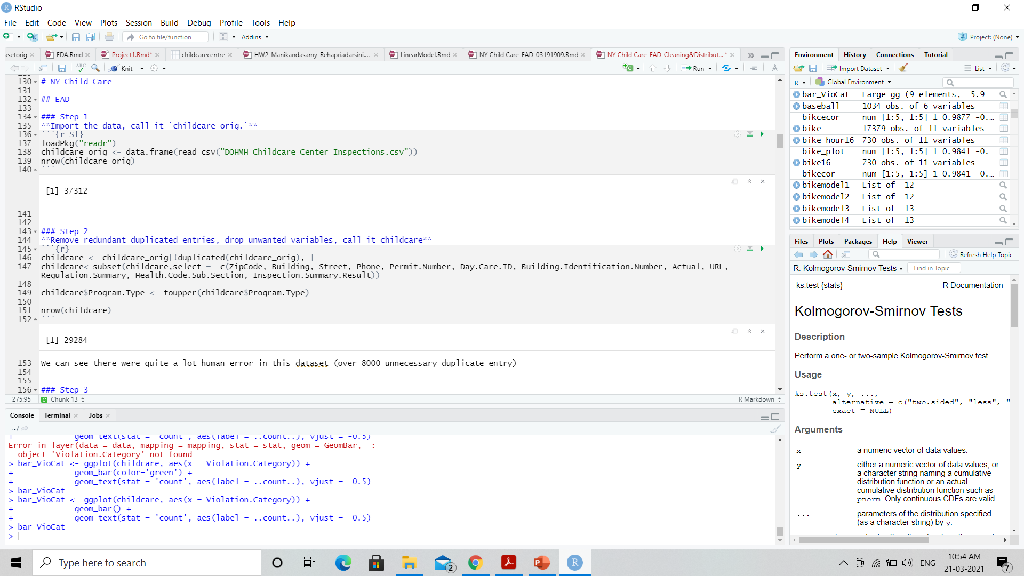
EDA
Removed redundant duplicated entries
Dropped variables which doesn’t make much impact for the analysis

Slide 7
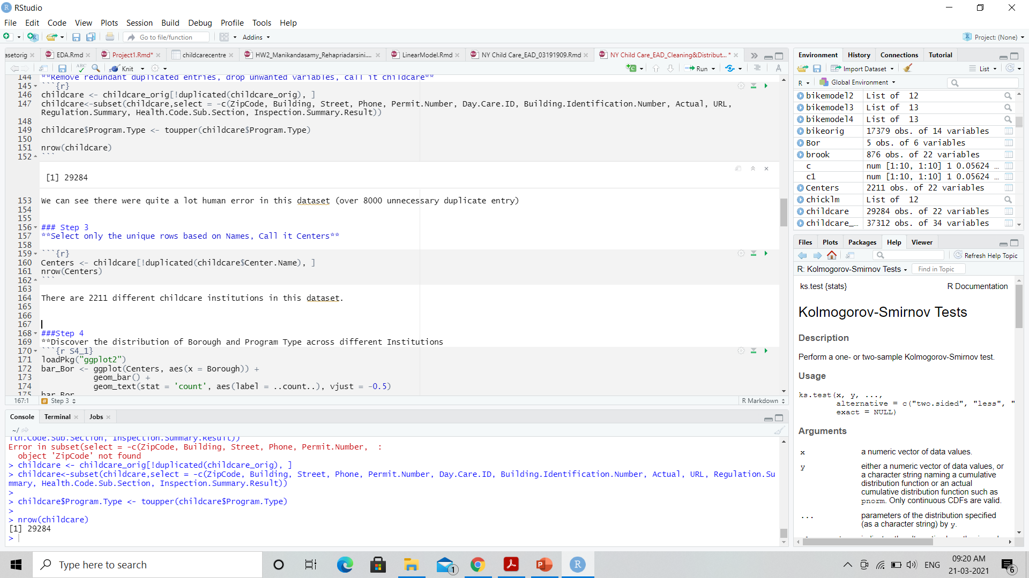
EDA
Selected only the unique rows based on Center Names
Graphs used:
Donut Chart
Bar plot
Histogram
Box plot
Line plot

Slide 8
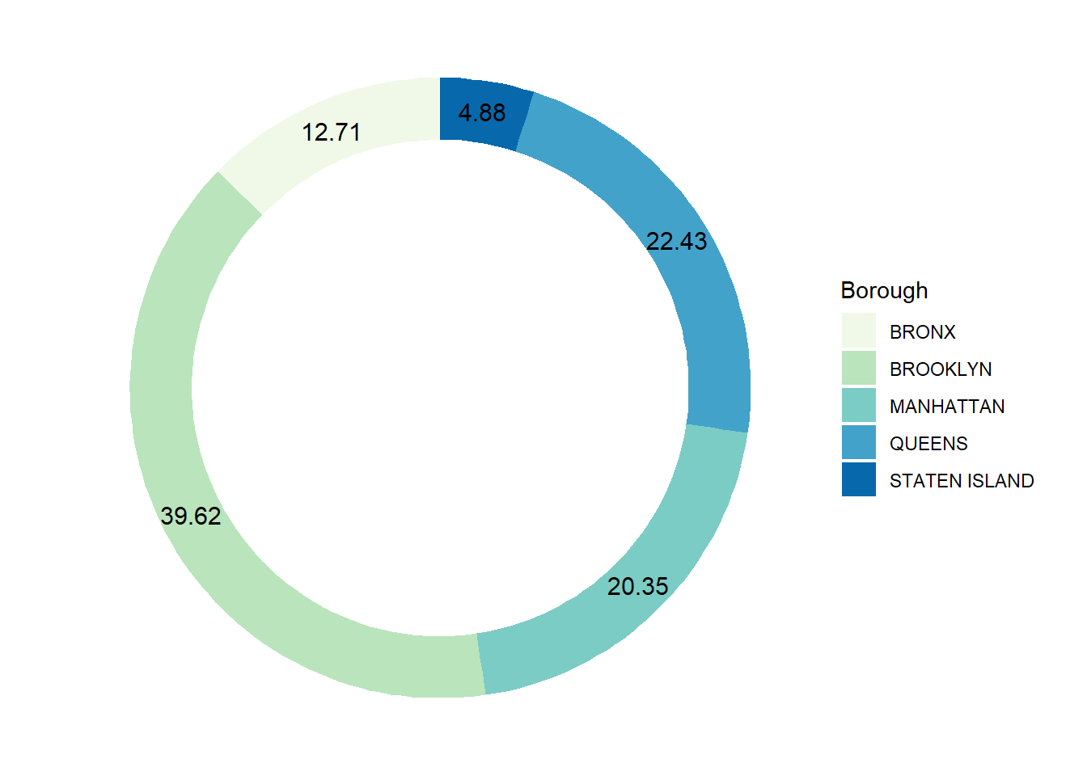
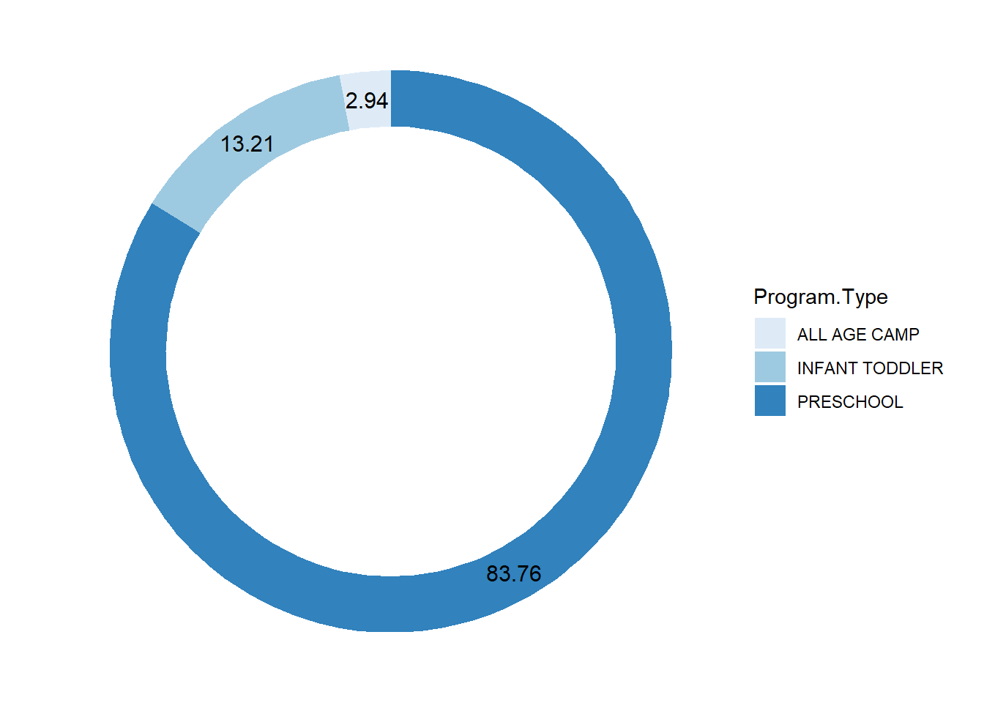
Discover the distribution of Centers, Borough and Program Type
Donut representation of centers and Borough
Donut representation of Centers and Program Type

Slide 9
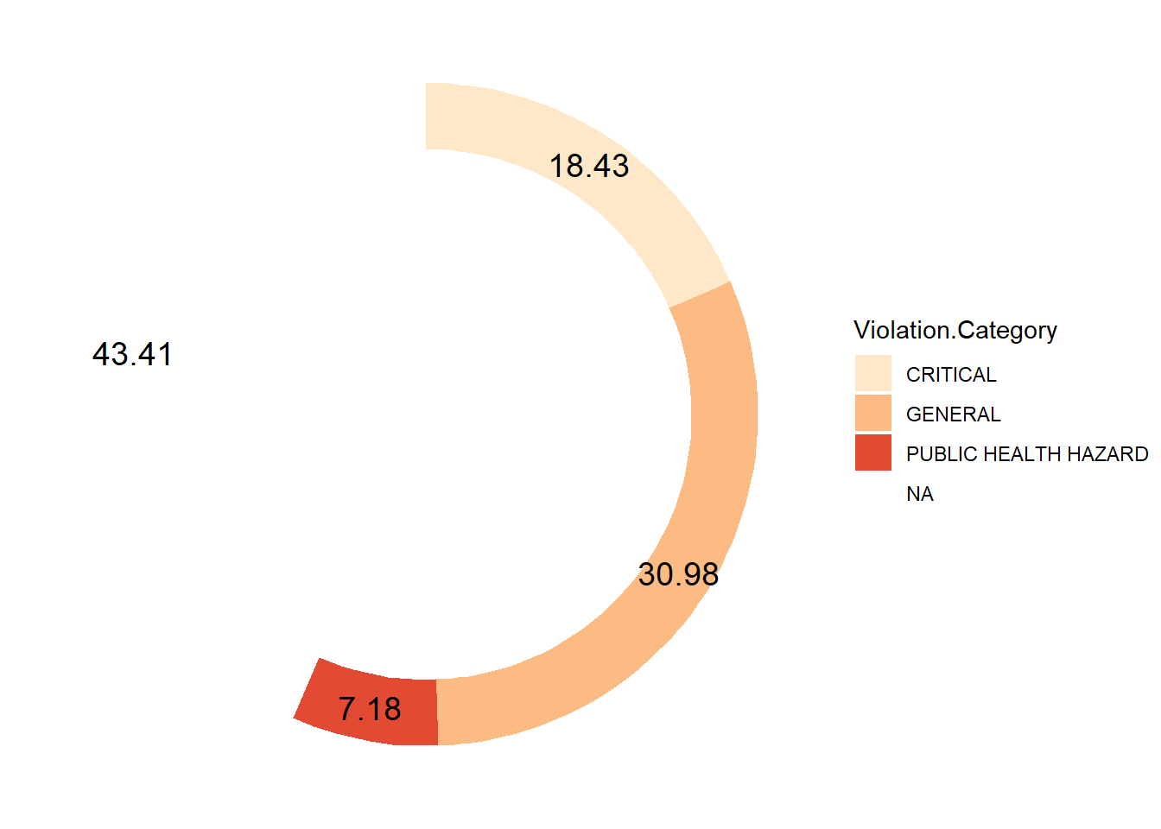
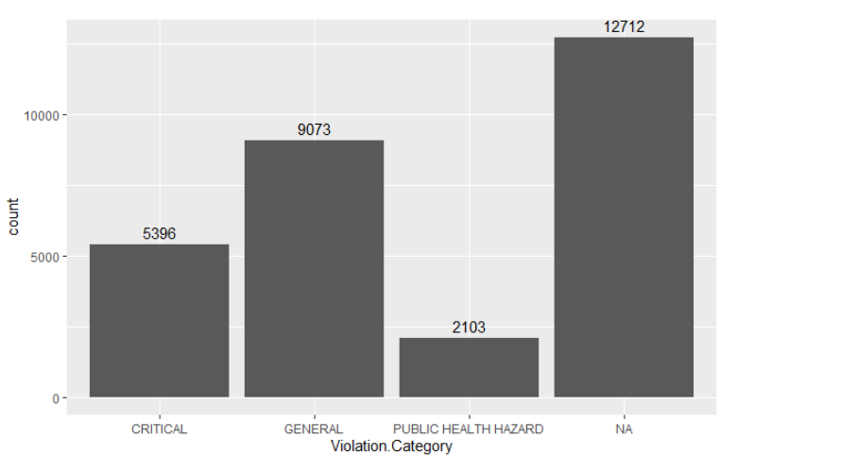
What is the percent of violations reported in each category in all the childcare centers
Bar plot of number of violations recorded in each category
Donut Representation (in percent)
The NA in Violation Category means no violation was detected during that inspection. Only around 43.41% of the inspections where violation-free

Slide 10
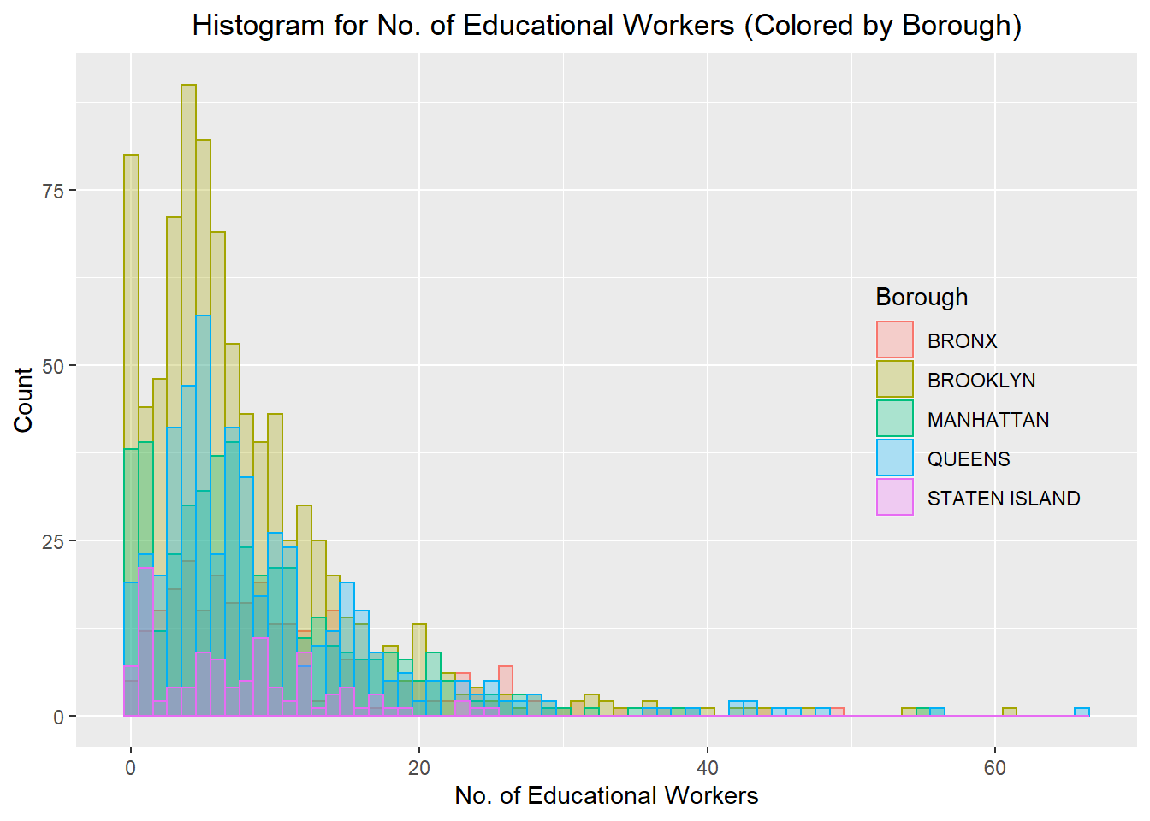
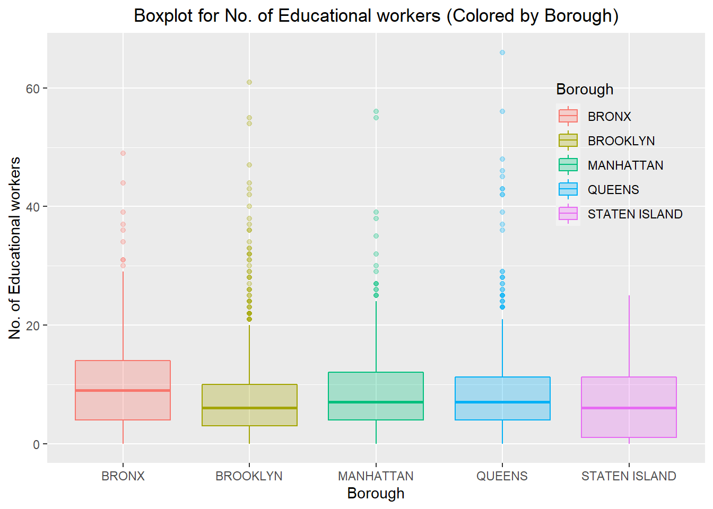
How many educational workers are distributed across each borough
Median: 7 workers; 80% quantile: 13 workers

Slide 11
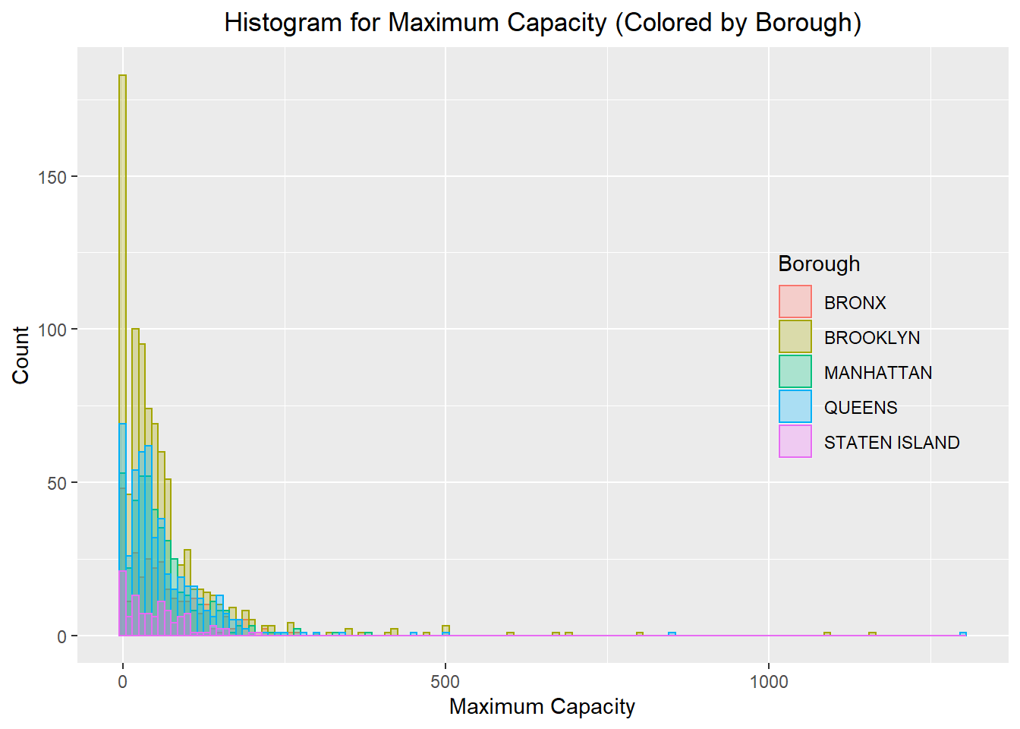
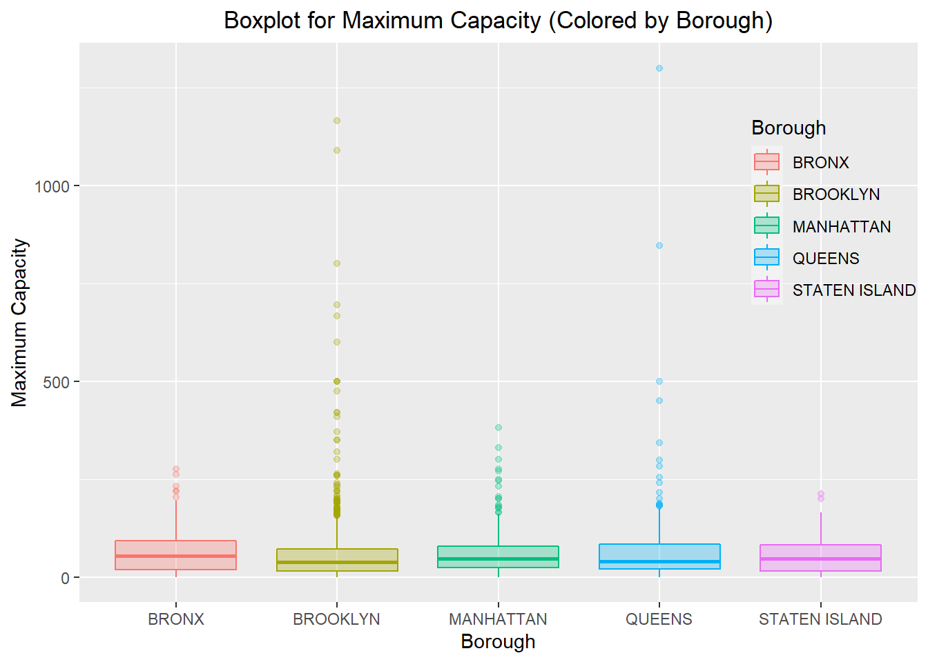
Maximum capacity of children in each borough
Median: 41 children; 80% quantile: 94 Children

Slide 12
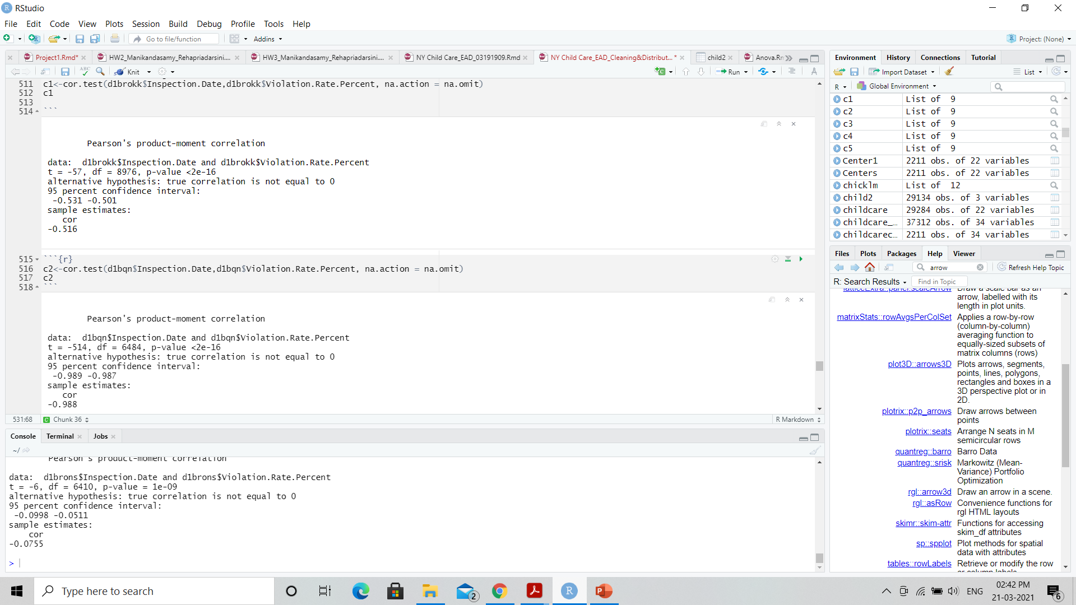
Correlation Test : Which borough has improved over the period (2018-2021)
Cor.test()- Inspection date and Violation Rate (for Brooklyn)
Cor.test()- Inspection date and Violation Rate (for Queens)

Slide 13
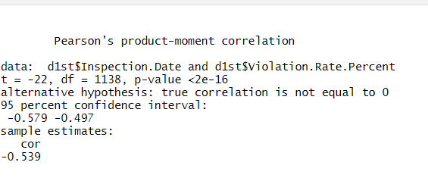
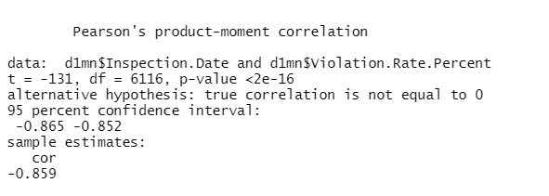
Cor.test()
Cor.test()- Inspection date and Violation Rate (for Staten Island)
Cor.test()- Inspection date and Violation Rate (for Manhattan)

Slide 14
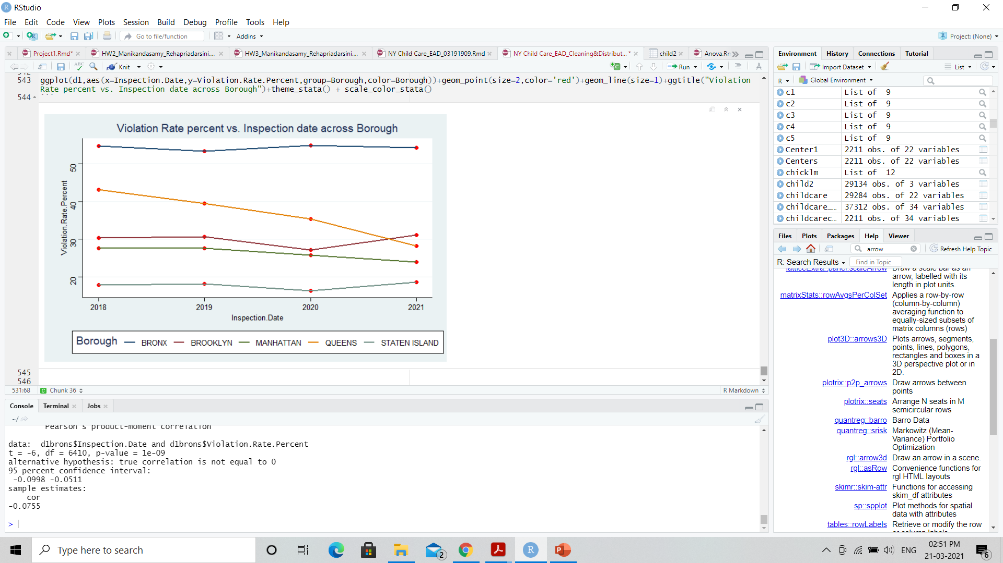
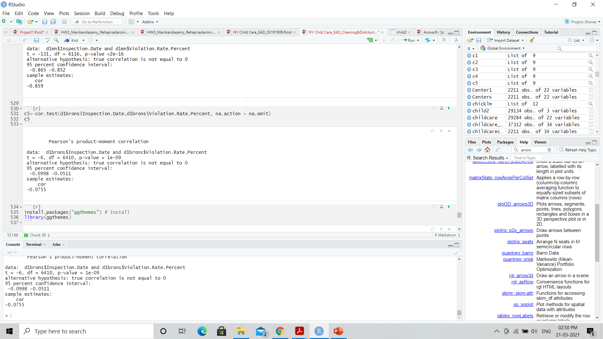
Cor.test()
Cor.test()- Inspection date and Violation Rate (for Bronx)

Slide 15
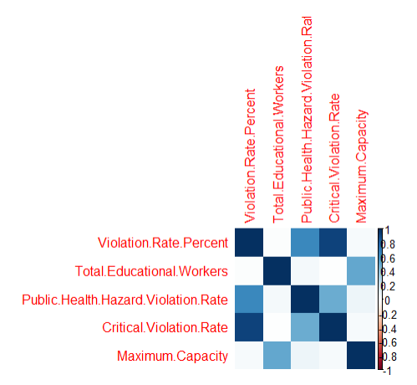
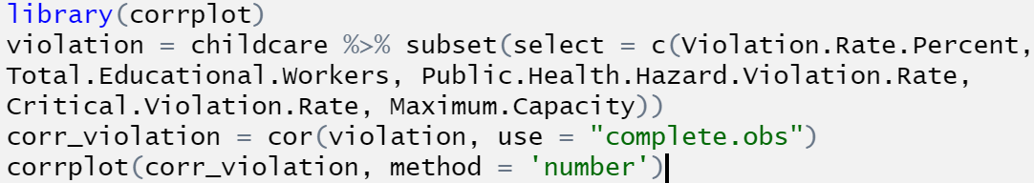
Correlation Matrix

Slide 16
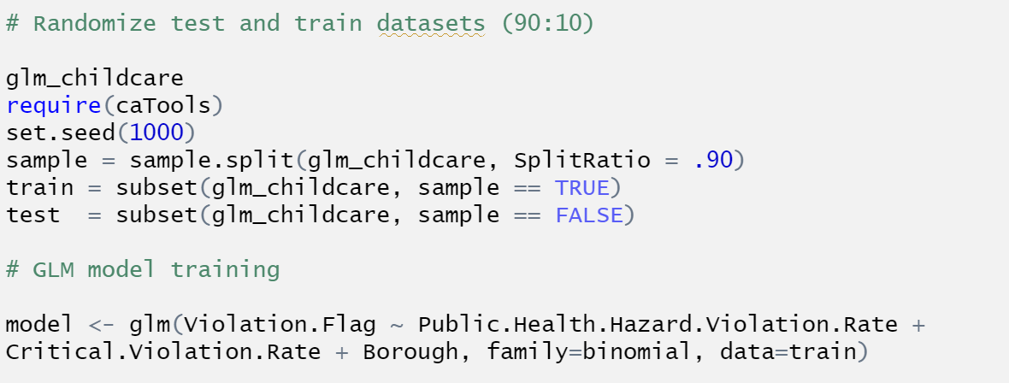
Generalized Linear Model
Building a Linear model(GLM):

Slide 17
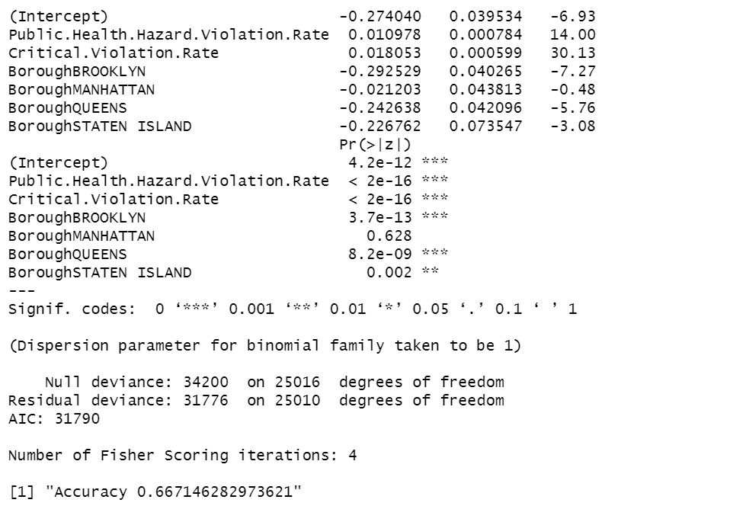
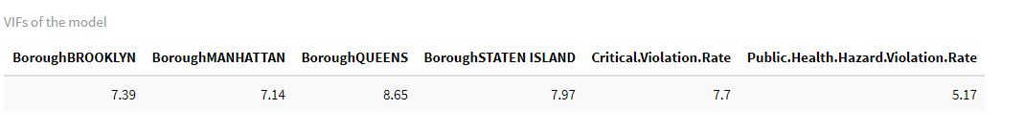
Model Summary
Summary & Accuracy:
Variance Inflation Factor(VIF)

Slide 18
Github Link :
https://github.com/adingankar/DATASCIENCE_6101

